Slide 1
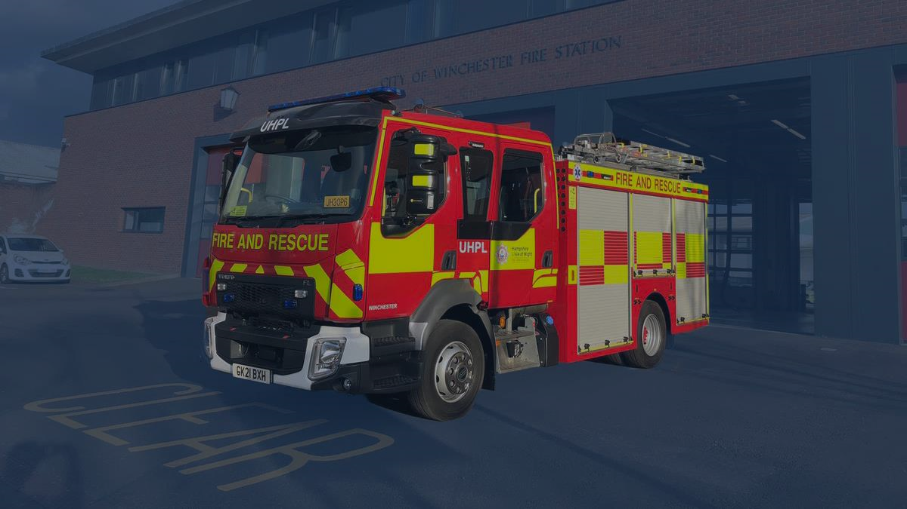
Fire, Self Neglect and Partnership Working
Paul Francis - HIWFRS Community Development and Safeguarding Manager

Slide 2
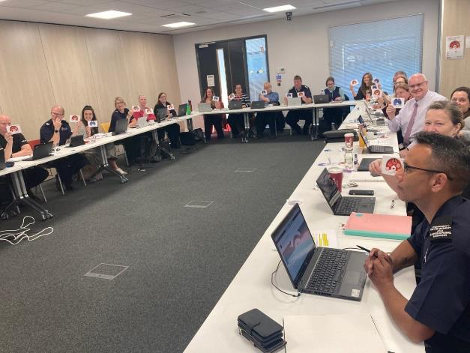
4LSAB Thematic Review 2019 – 2021 – Vulnerabilities and Risk Factors
The 4LSAB Fire Safety Development Group (FSDG) is a subgroup of the Four Local Safeguarding Adults Boards (4LSAB) in Hampshire, Southampton, Portsmouth and Isle of Wight.
The 4LSAB FSDG completes a multi-agency review of any fire incident which results in a serious injury or fatality.
The aim of this multi-agency review, is to identify key risk factors and vulnerabilities that the individual(s) involved with the fire incident was experiencing prior to the fire, and to identify if they were known to or in receipt of any support from services within the 4LSAB area.
A thematic review of 39 fire incidents resulting in fatality or serious injury between Jan 2019 and Dec 2021.
The multi-agency reviews and the thematic review have enabled us to identify key vulnerabilities and risk factors.

Slide 3
Three Pillars of Fire Vulnerability
Person Risk Factors
Fire Vulnerability
Behavioural Risk Factors
Environmental Risk Factors

Slide 4
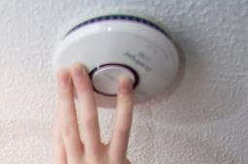
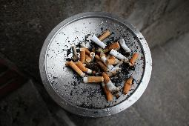
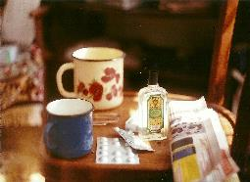
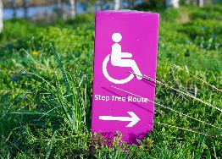
4LSAB Thematic Review 2019 – 2021 – Vulnerabilities and Risk Factors
79% of individual had needs of care and support.
56% of individual were in receipt of care and support services at the time of the incident
18% of incidents had no smoke detection and another 8% had non functioning detection
88% of individuals lived alone
54% of individuals identified as having poor mental health as a vulnerability
64% of individuals had smoking as a risk factor
38% of individuals had poor mobility or a physical impairment
46% of individuals had alcohol and/or substance misuse
44% of individuals were identified to be experiencing self neglect
13% of individuals had hoarding within their home

Slide 5
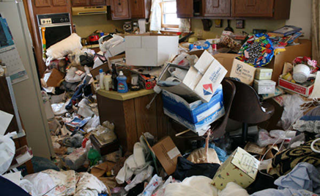
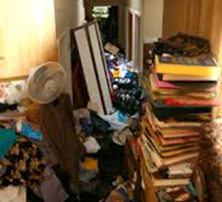
Hoarding
Establishing the fire risks
Can the room be used for its intended purpose?
Storage of excessive amounts of combustible items?
Separation between combustible items and ignition sources?
Reduced accessibility means repairs not reported and carried out?
Risks presented by Hoarding
Accelerated fire spread and intensity / increased smoke development
Flammable liquids / cannisters within the property
Impact upon an individual(s) ability to evacuate
Reduced opportunity to close doors (and create compartmentalisation)
Risks to those living adjacent due to increased smoke and fire conditions
Risks to operational Firefighters
Increased heat and risk of flashover
Reduced visibility
Limited access and ingress to search property
Structural instability
Entrapment of crews
Search patterns compromised
Fire fighting tactical options reduced
Morale dilemma…

Slide 6
Clutter image rating – 4LSAB Hoarding Guidance 2021

Slide 7
Case Study – Mrs W
Mrs W was 76 years of age with poor mobility, poor mental health, smoked and consumed alcohol and lived alone in a supported housing property.
Mrs W had a long standing history of self neglect and hoarding, with a lack of engagement with support services, and limited family and social network.
Mrs W had a substantial fear of agency involvement – due to previous property clearance when she was in hospital
Mrs W had a history of fire incidents.
Agencies involved / concerned:
HIWFRS attendance would result in safeguarding referrals and safe and well intervention – continuous cycle
Environmental Health considering legal action due to the impact on neighbouring properties
Housing at risk - breach of tenancy, and failing to engage with improvement notices
Adult Services – referrals received but undetermined care and support or assess capacity due to refusal of engagement

Slide 8
Case Study – Mrs W
Overtime a rapport was established between Mrs W, the attending HIWFRS Operational Crews and the HIWFRS Community Safety Officer.
HIWFRS initiated a MARM with the involvement of all key agencies and Mrs W’s nephew to represent her views and wishes (Mrs W did not wish to engage directly).
The co-ordination of the support from and involvement of the different agencies via the MARM process reduced the fear and hesitation from Mrs W to engage.
An action plan was established, including
A support Worker being considered to support Mrs W with reducing the hoarding
Involvement of Health professionals to give Mrs W a health check
Pause on formal action being taken by Environmental Health and Housing
Safe and Well / Fire Risk advice offered to neighbours
What did this case need?
A co-ordinated multi-agency approach
Time and patience
Understanding of the reasons for Mrs W’s hoarding behaviour and hesitance to engage
The ability to be flexible and creative in engagement with Mrs W

Slide 9
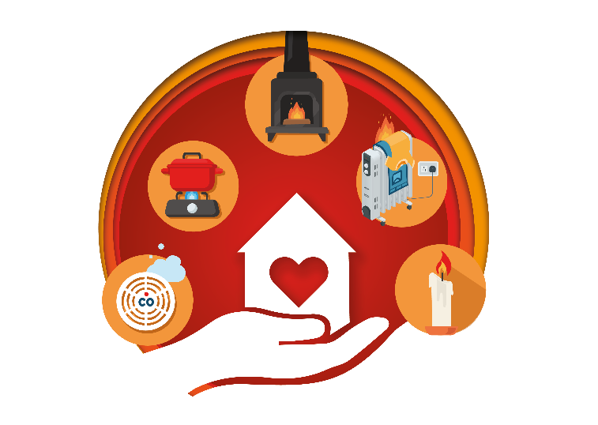
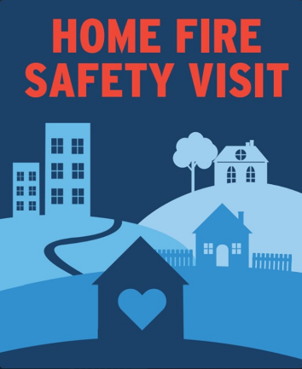
Safe and Well (Home Fire Safety) Visits
A Safe and Well visit is a person-centred home fire safety visit based upon a person's health needs, behavioural factors and their home environment.​
​
The primary aim of a Safe and Well visit is to mitigate and reduce fire risk within the home by trying to influence a change in behaviour that may affect or increase the occupant's exposure to increased fire risk.​
During a Safe and Well visit we will:​
​
Identify any potential fire risks and discuss with the occupier how they can prevent or reduce the risk.​
Ensure occupants have working smoke alarms, install where necessary, and advise on maintenance and testing.​
Help put together a household escape plan and identify any mobility issues that may impede on evacuation.​
Issue fire retardant bedding, furniture throws and nightwear where needed.​
Give basic advice on topics such as falls prevention and smoking.​

Slide 10
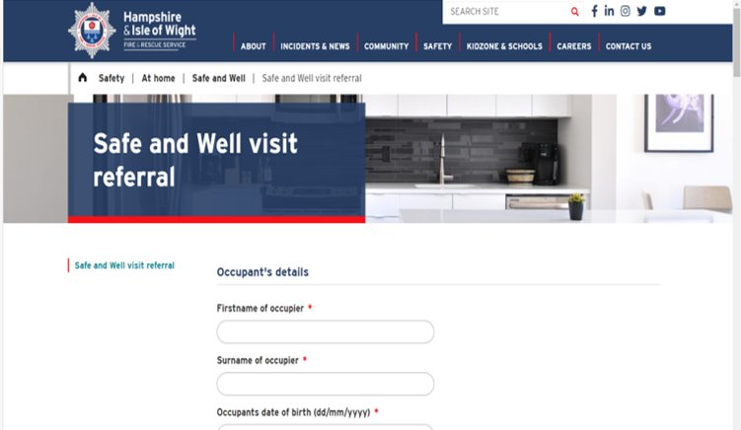
Safe and Well Referrals
Follow this link to refer anyone you feel would benefit from a Safe and well visit.​
Please include a contact number and complete as many fields as possible to help us to ensure the individual/s receive the most appropriate response.​
If you would like confirmation once the visit has been completed then please add your email address.​
We will only ever share data that is appropriate to support the ongoing care of an individual. ​

Slide 11
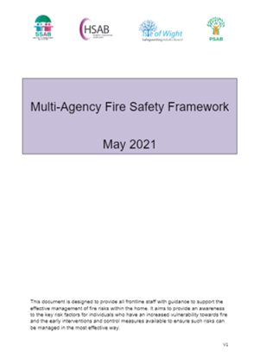
4LSAB Multi Agency Fire Safety Framework
​
This ‘overarching’ framework is designed to provide all frontline staff with guidance to support the effective management of fire risks within the home.​
The Framework provides an awareness to the key risk factors for individuals who are presenting an increased vulnerability to fire and the early interventions and control measures available to ensure such risks can be managed in the most effective way​
Vulnerability Factors​
HIWFRS Prevention and Early interventions​
Mental Capacity considerations​
Person Centred Fire Risk Assessment (Template)​
Safe Smoking Risk Assessment (Template) ​
Safe and Well Referral Pathway

Slide 12
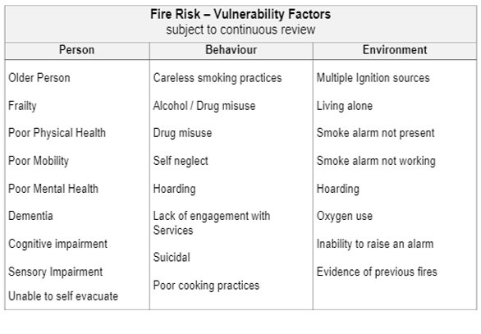
4LSAB Multi Agency Fire Safety Framework
Fire Risk Vulnerability Factors
‘If one or more of the vulnerability factors are identified, then a person centred fire risk assessment should be completed, and a Safe and Well referral to Hampshire and IOW Fire and Rescue Service should be considered

Slide 13
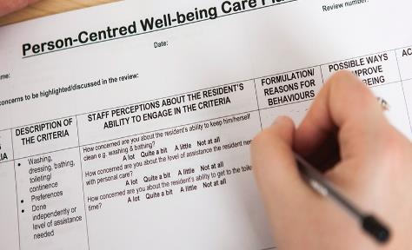
4LSAB Multi Agency Fire Safety Framework
Person Centred Fire Risk Assessment
To ensure an individual’s vulnerability to fire is continuously managed, you should consider the use of the ‘Person at Risk’ Fire Risk Assessment as detailed in Appendix 1 of the framework.​
The ‘Person at Risk’ Fire Risk Assessment is suitable for all individuals regardless of where they are residing (at home; supported housing ; care home setting)
The Framework also provides a ‘Safe Smoking Risk Assessment’ Template
​
The risk assessment should be completed and reviewed in accordance with an individual’s care plan arrangements
4LSAB Multi Agency Fire Safety Framework

Slide 14
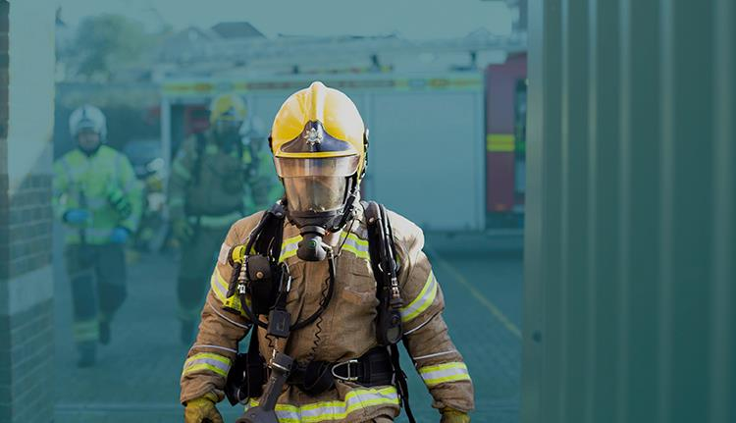
Questions?

